Slide 1

PROJECT WORK

Slide 2
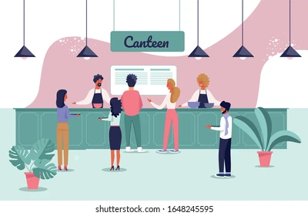
AROUND THE COUNTER

Slide 3

FEATURES OF WEBSITE
The front and the main web page enables the user to search for various food available in the different canteens around BMSCE.
In addition to these the user can also have a look on all the best selling food items while being able to read reviews of each of them given by their peers.
User will be able to create an account that helps you keep track of their current order and their previous.
The Unique feature about the website is that it provides a user to user interface option.
user to user interface option.

Slide 4
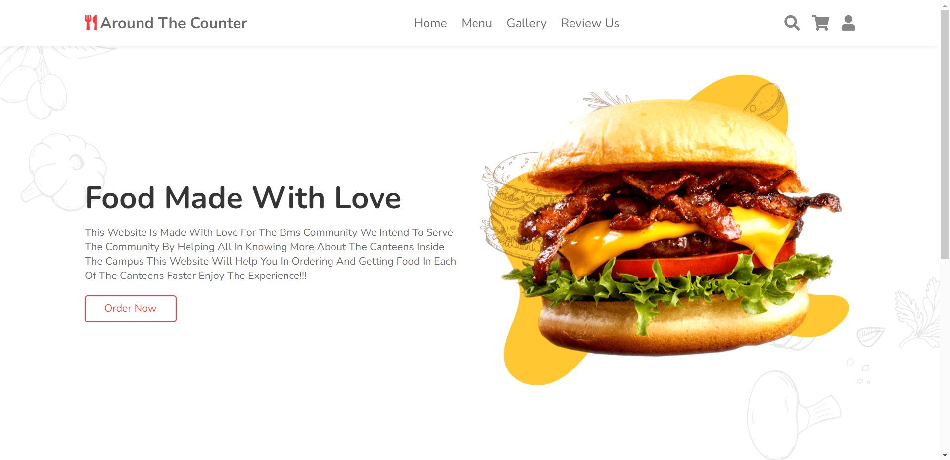
MAIN PAGE

Slide 5
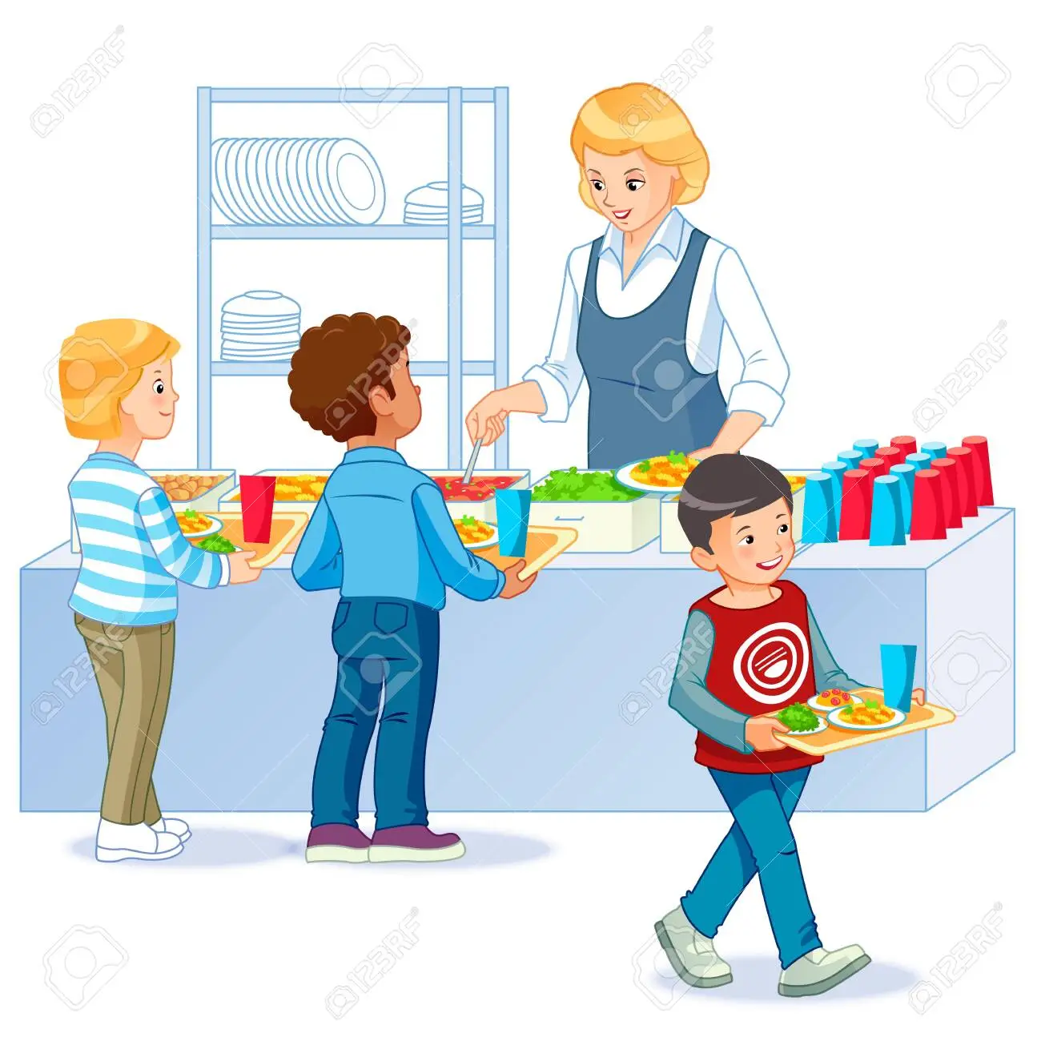
FEATURES OF THE MAIN PAGE
HOME
MENU
GALLERY
REVIEW US
SEARCH
CART
LOGIN ACCOUNT

Slide 6
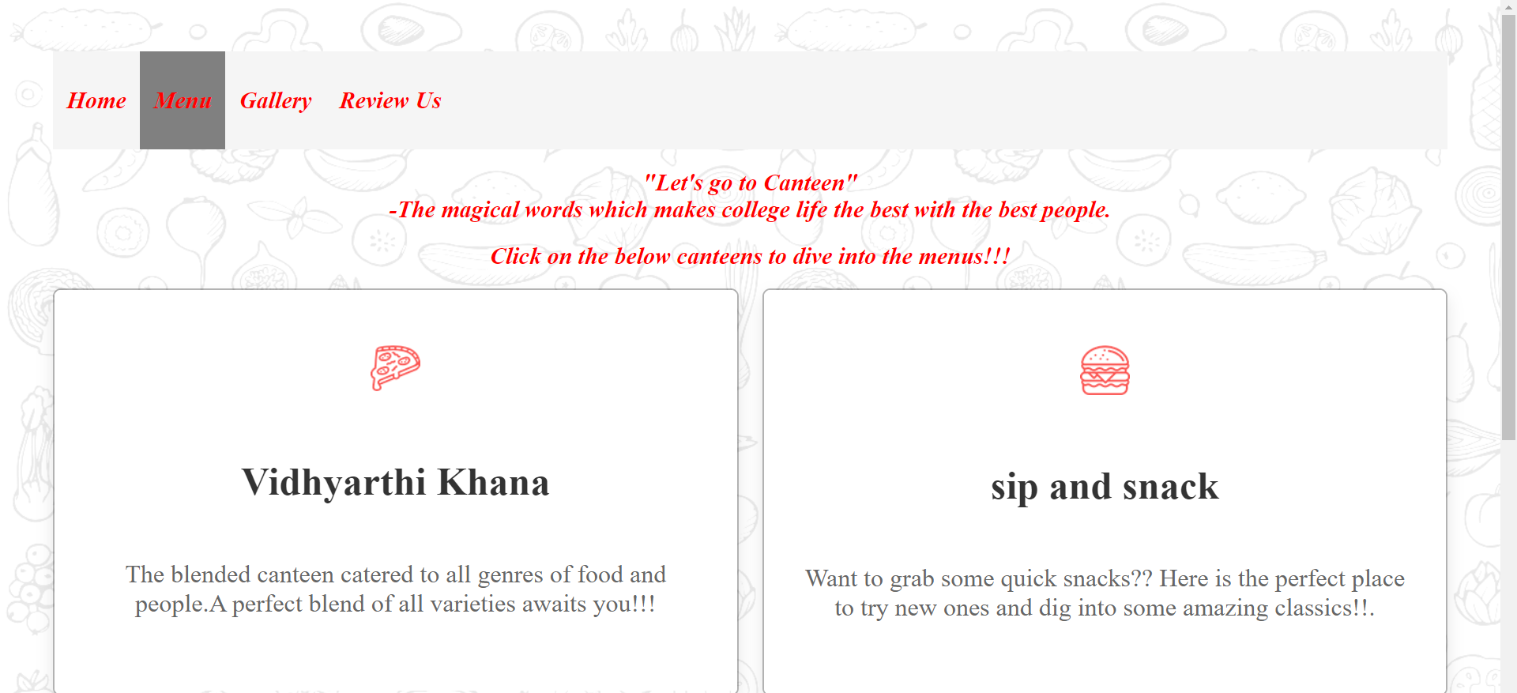
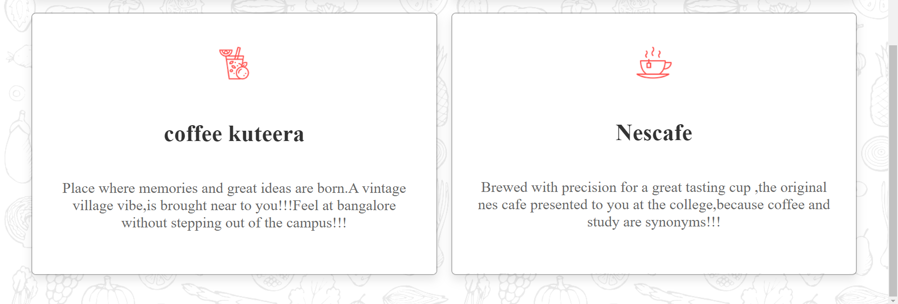
MENU

Slide 7
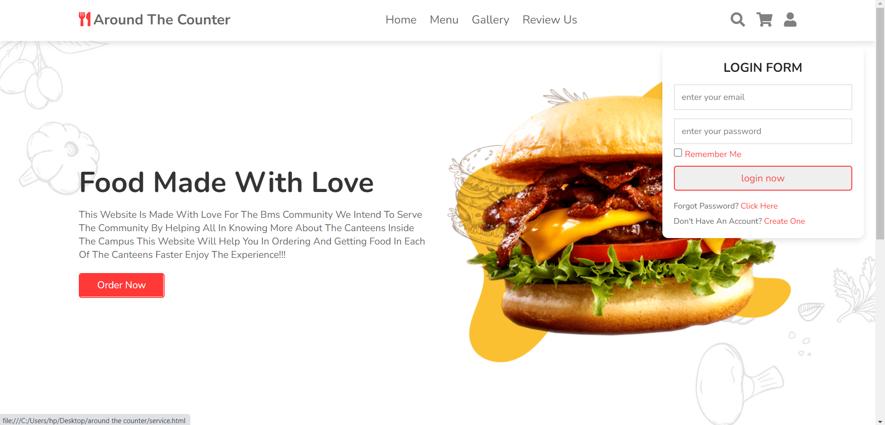
LOGIN PAGE

Slide 8
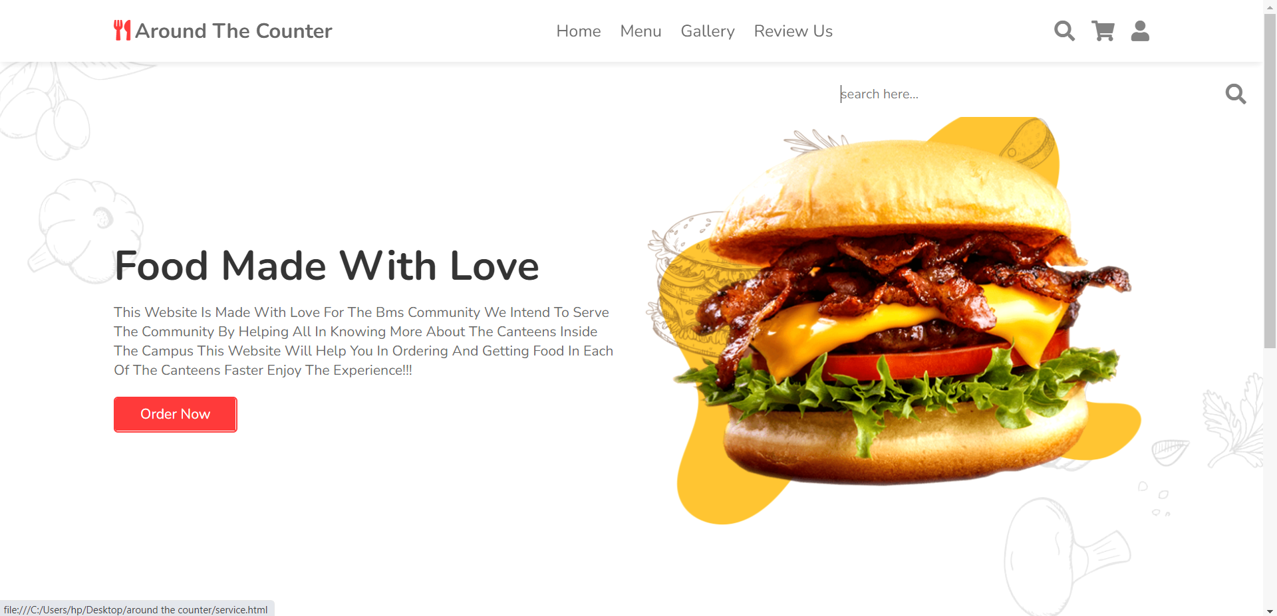
SEARCH BUTTON

Slide 9
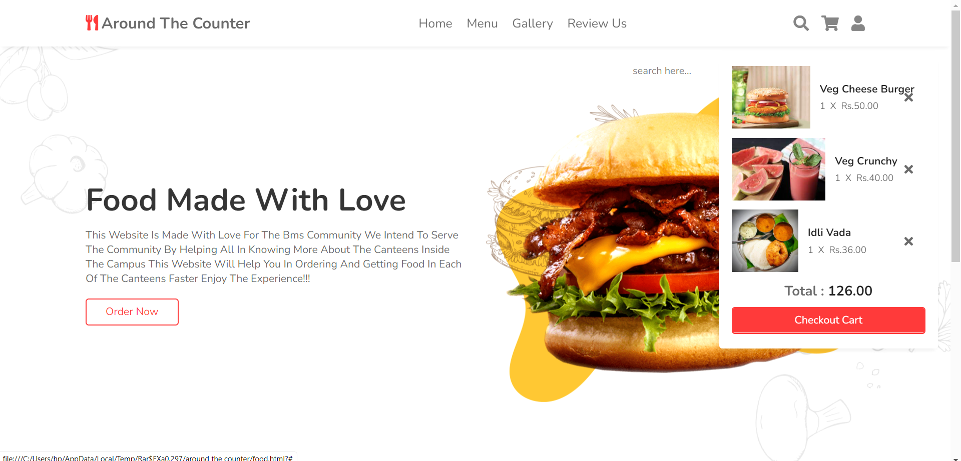
MY CART

Slide 10
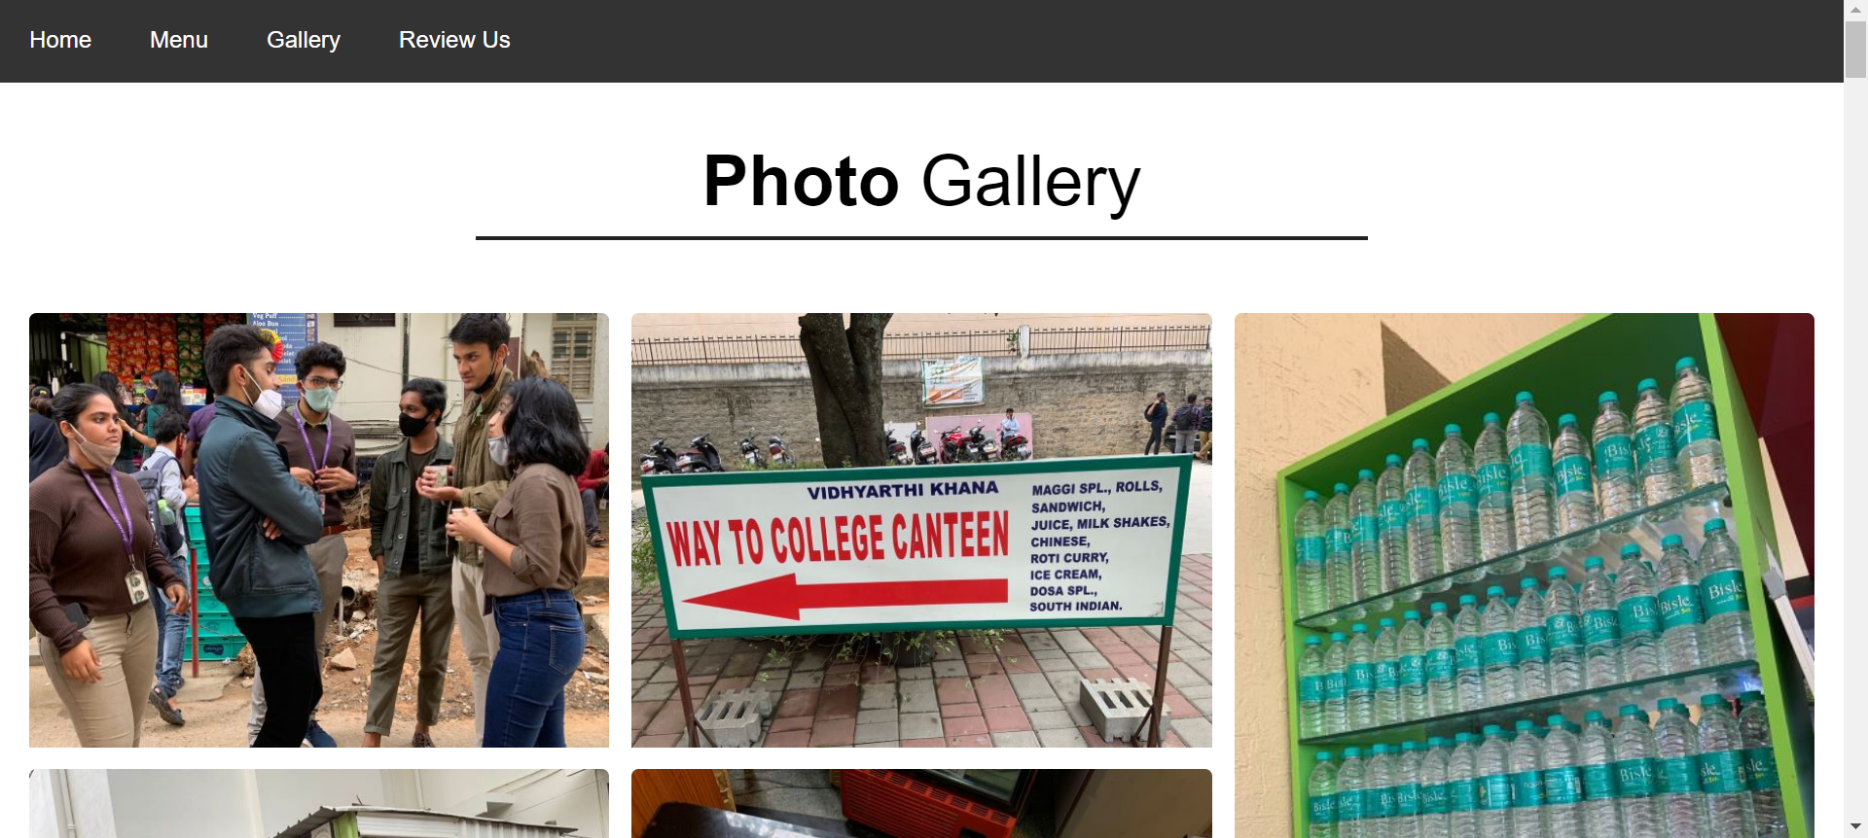

Slide 11
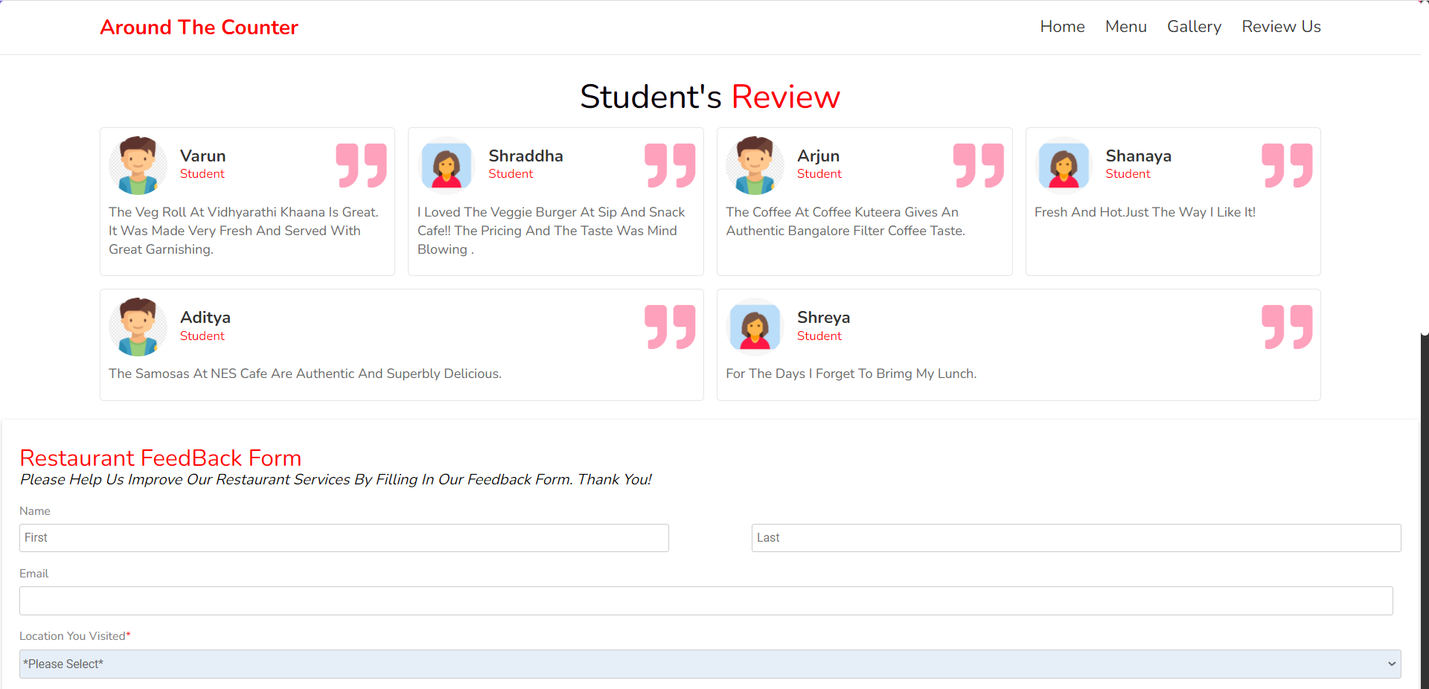
REVIEW US

Slide 12
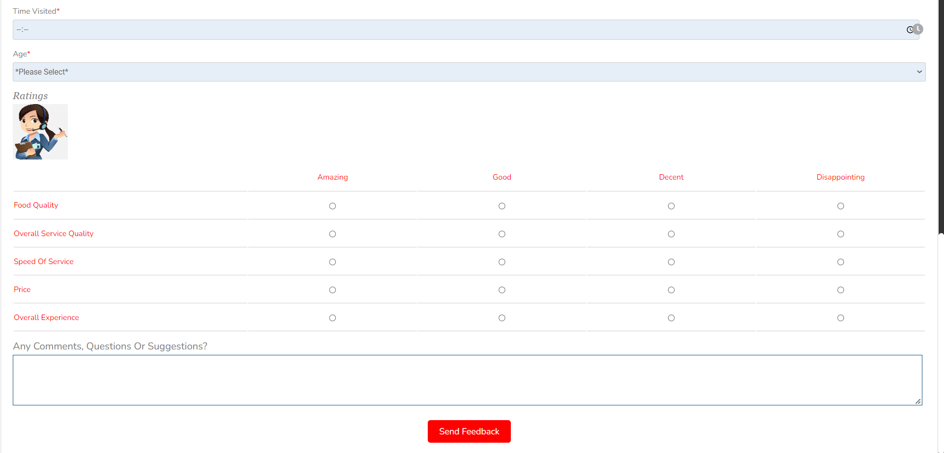

Slide 13
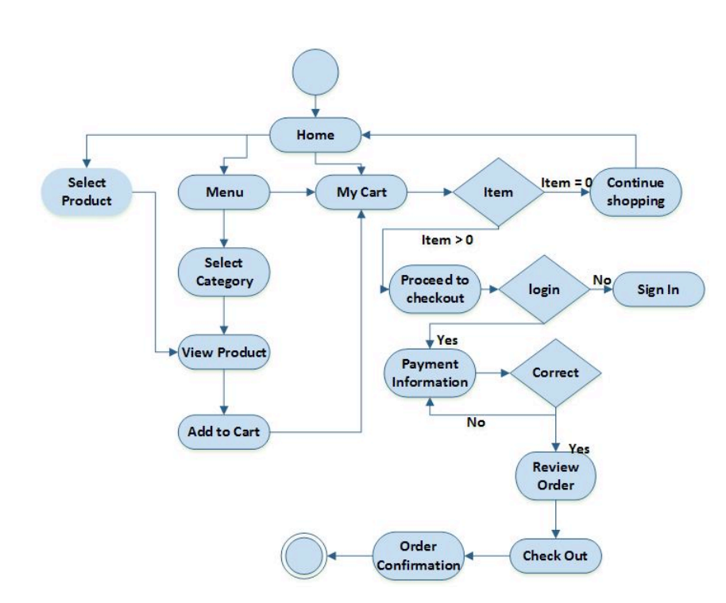
SYSTEM ARCHITECTURE

Slide 14
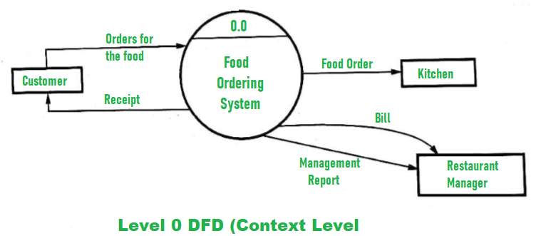
A FEW FLOW CHARTS TO DEMOSTRATE HOW THE WEBSITE WORKS

Slide 15
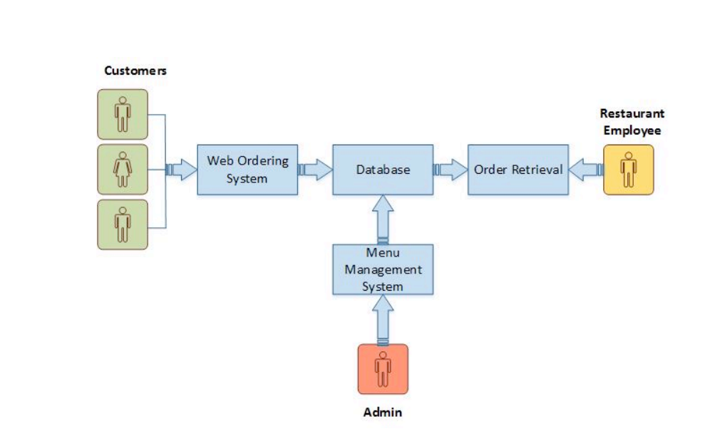
SYSTEM MODEL

Slide 16
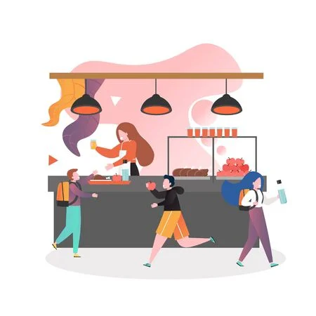
WHY AROUND THE COUNTER ????
The UNIQUE FEATURE which is the fact that students can order their food online which provides you a chance to avoid long queues and get a faster delivery with pre paid option
The user can make pre paid payments
This in turn helps certain users to get their desired food quicker.

Slide 17

LANGUAGES USED

Slide 18

TEAM MEMBERS:
SIRI PRAHLAD-1BM20CS160
SPOORTHI UDUPA-1BM20CS161
SRIDEVI KP NAIK-1BM20CS162
SUPRIYA S C-1BM20CS165

Slide 19


